Slide 1

RECAP — Rapid Event-level Classification of Affected Properties
By: Yatin Raju, Aryan Anand, and Sri Satishkumar

Slide 2
Project Recap:
Satellite imagery used for post-disaster building damage assessment
Four categories: No Damage, Minor, Major, Destroyed
Goal: provide fast, accurate, scalable classifications
Supports first responders & recovery efforts
Notes:
Before diving into the metrics, here’s a quick overview of the project. Our goal was to use satellite imagery to automatically classify building damage after disasters. We trained our model to recognize four levels of damage: no damage, minor, major, and destroyed. The purpose of this work is to provide rapid, accurate, and scalable assessments to help first responders and aid organizations prioritize resources where they’re needed most.

Slide 3
Key challenges:
Latency challenge
Our pipeline must process thousands of 512×512 tiles on CPU-only machines which results in super long training periods.
If p95 time per tile is too high, the end-to-end map takes hours.
GeoTIFF challenge (blocking map UX)
The xBD split we use provides PNG chips + JSON masks but no lat/lon. True georeferencing lives only in a ~131 GB GeoTIFF per event.
We can’t plot results on a real basemap yet; the demo shows pixel-space points
Notes:
One of the biggest issues we face is latency. Our pipeline has to process thousands of 512 by 512 image tiles, and because we’re running on CPU-only machines, training and inference take a really long time. If the p95 time per tile is too high, the entire end-to-end map can take hours to generate, which makes it impractical for rapid disaster response.
Another challenge is with georeferencing. The dataset we use, xBD, gives us PNG image chips and JSON masks, but no actual latitude and longitude information. The true geospatial data is locked inside massive ~131 gigabyte GeoTIFF files for each event. Because of this, we can’t yet plot results directly onto a real basemap. For now, our demo only shows pixel-space outputs instead of georeferenced maps.

Slide 4

Approaches
Approach #1
Approach #2
Object-aware & interpretable: First find buildings (Stage-1), then grade each building’s damage (Stage-2). Outputs are per-building labels, confidences, and overlays—easy for responders to trust and act on.
Leverages “before vs after” signal: A Siamese ResNet-18 compares pre vs post crops to focus on what changed, reducing noise from background clutter and lighting differences.
Modular & debuggable: You can improve or swap either stage independently (better seg model, better classifier) and diagnose errors (missed building vs misclassified damage) quickly.
Practical for class & deployment: Uses standard torchvision models, trains on a laptop, and exports clean artifacts (CSV/GeoJSON/overlays) that plug straight into a simple app or map.
Straight to the point: Instead of first detecting buildings, it trains directly on pre-cropped building images (“before” + “after”) from the dataset. This keeps the pipeline simple and fast.
Handles imbalance: Uses tricks like re-balancing and a special loss function so the model doesn’t just predict “no damage” all the time. Helps it pay more attention to the rarer “major” and “destroyed” cases.
Well-tuned training: Runs on a ResNet model adjusted to take both before/after images. Training uses modern settings (AdamW optimizer, cosine learning rate schedule, checkpoints) and pre-saved chips for speed.
Ready to show: Outputs a clean CSV of predictions that feed right into our Streamlit app, where responders/classmates can see maps, filter results, view Grad-CAM explanations, and inspect individual buildings.

Slide 5

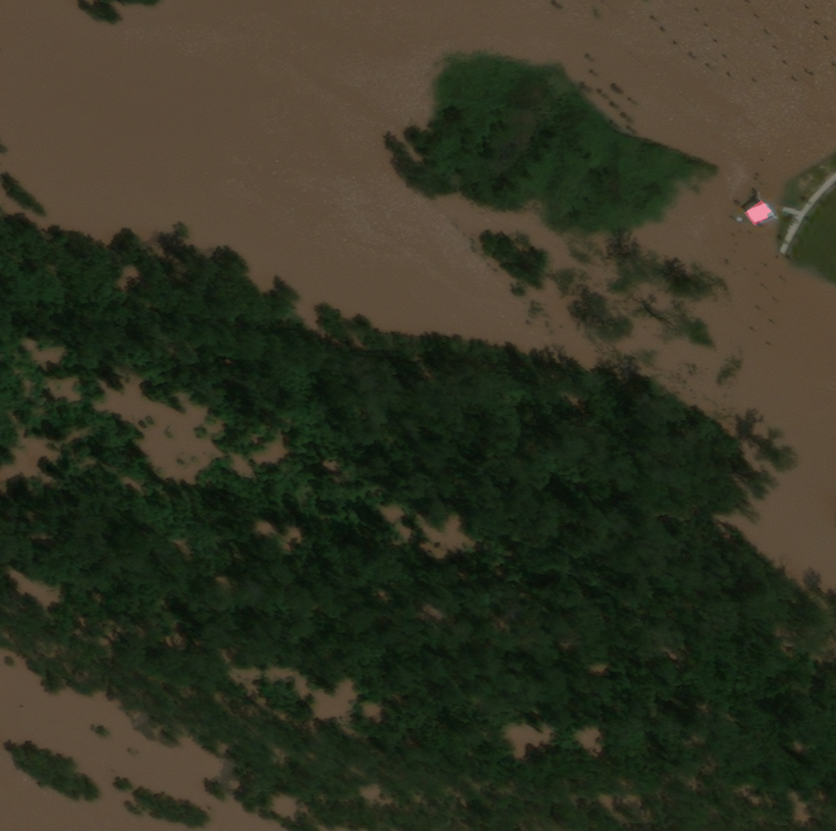
Visualizing Damage Detection: Mask vs. Overlay
Notes:
Here’s a visual example of our data overlay process. On the left, we have the mask, which highlights damaged structures using a specific color—here it's marked in red. On the right, you can see the corresponding satellite image, where the same structure is visible in the natural environment. This kind of overlay helps us validate model predictions and better interpret where damage has occurred, especially in post-disaster settings."

Slide 6
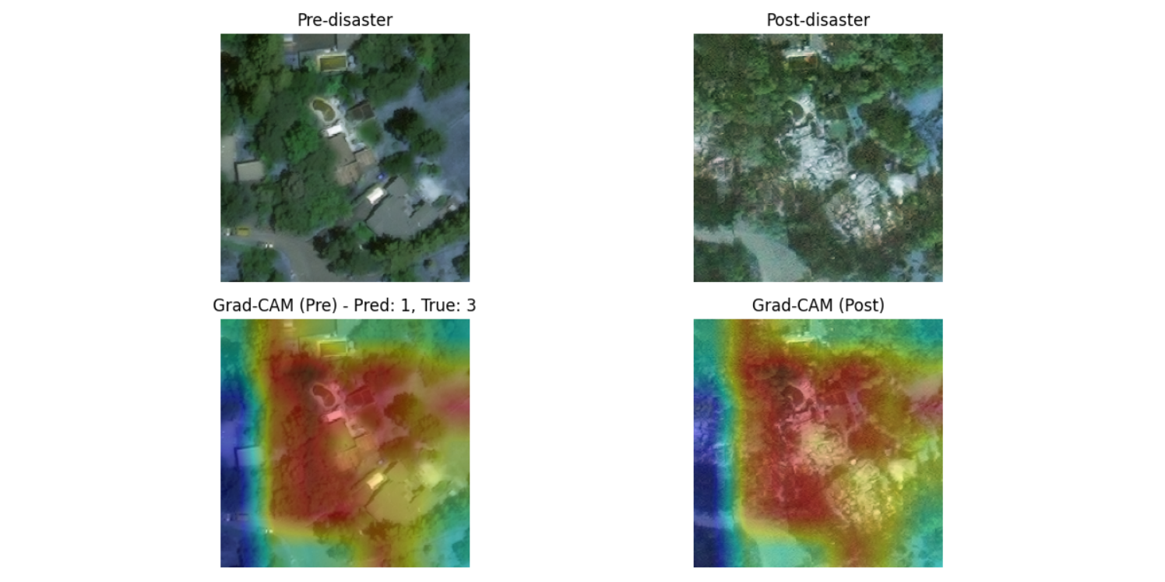
Notes:
In this first example, we’re looking at a misclassification case.
On the top left is the pre-disaster image, and on the top right is the post-disaster image.
Below each, you see the Grad-CAM visualizations showing where the model focused its attention.
The model predicted class 1 — which corresponds to minor damage — but the true label was class 3, or destroyed.
As we can see from the Grad-CAM, the model’s attention was a bit diffuse in the pre-disaster image, possibly leading to the misclassification. This highlights how subtle visual differences can confuse the model.

Slide 7
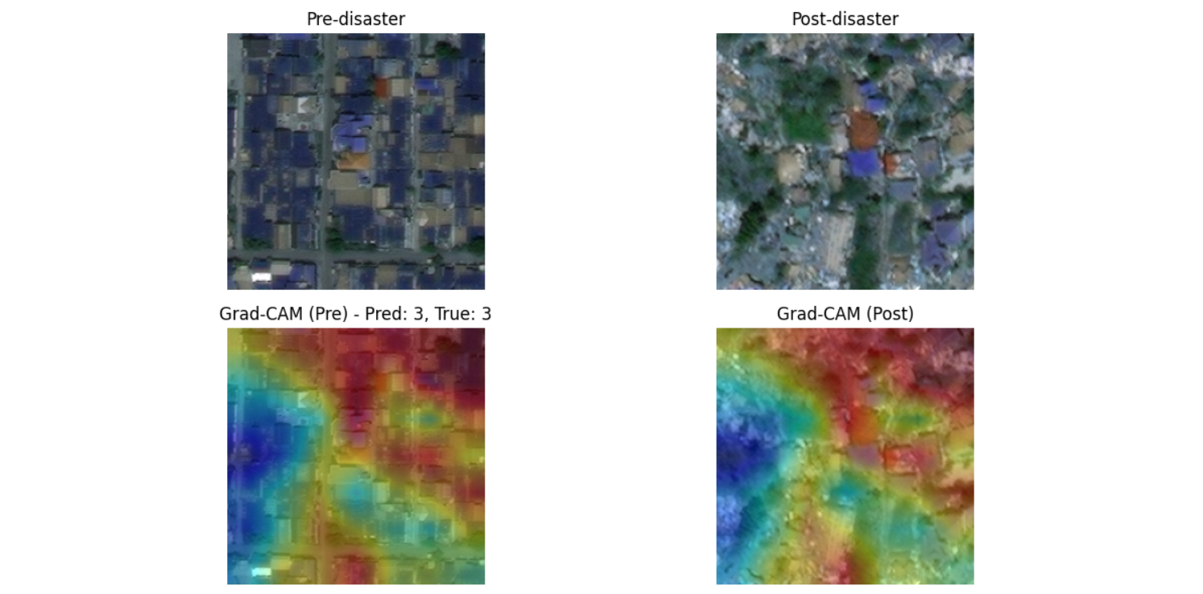
Notes:
Now here’s an example of a correct prediction.
Again, we have the pre-disaster image on the top left and the post-disaster image on the top right.
The Grad-CAM visualizations show that the model focused strongly on the most relevant damage zones — you can clearly see the red highlights align with areas of destruction.
Both the prediction and the ground truth were class 3, or destroyed.
This demonstrates that when the features are more obvious and the model’s attention is well-placed, it performs with high confidence and accuracy.

Slide 8
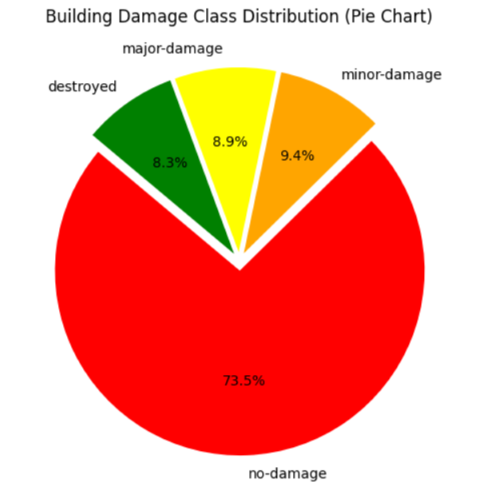
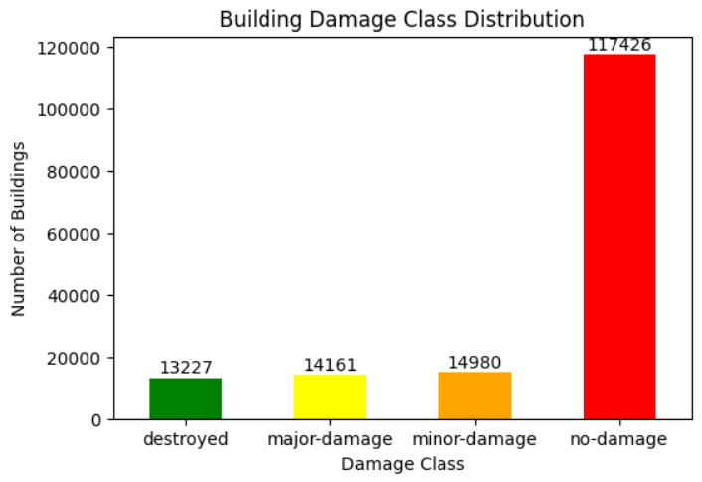
Notes:
Both show that the dataset is heavily imbalanced: about 73% of the buildings fall into the ‘No Damage’ category. In contrast, the damaged categories — minor, major, and destroyed — each make up less than 10% individually.
This imbalance creates a challenge for the model because it can easily learn to predict ‘No Damage’ most of the time and still appear accurate, while struggling more on the smaller but more important damaged classes.
To handle this imbalance, we can use a few different strategies. One option is resampling — either oversampling the less common classes or undersampling the majority class. Another is to use class weights, which essentially tell the model to pay more attention to the rarer categories. We can also generate more training examples through data augmentation, creating slightly modified versions of the minority class images. Finally, when we evaluate performance, we rely more on F1-scores and recall, instead of just accuracy, so we don’t overlook the rare but critical damage classes.

Slide 9
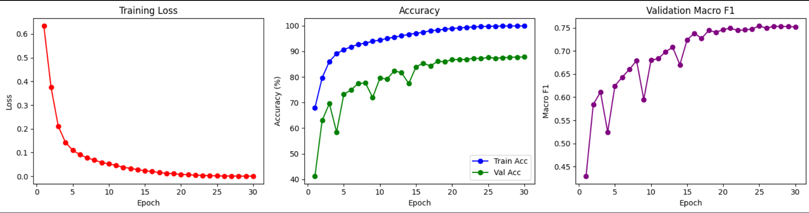
Notes:
**“This graph shows how our model improved as we trained it. On the left, the red line is the training loss. You can think of ‘loss’ as how wrong the model is — it starts high, and drops down quickly, which means the model is learning.
In the middle, the blue line is training accuracy and the green line is validation accuracy. Training accuracy goes up almost to 100%, while validation accuracy levels off around 87–88%. That’s expected — the model learns the training data really well, but validation accuracy shows how well it generalizes to unseen data.
On the right is Macro F1, which balances performance across all four damage classes, including the rare ones. This steadily climbs from about 0.45 to around 0.75. That’s important, because it shows the model isn’t just good at predicting the easy ‘no damage’ cases, but also improved on the harder classes like ‘minor’ and ‘destroyed’.
Overall, these three plots together show that our model trained successfully, learned the patterns, and reached strong balanced performance.”**

Slide 10
Real Data & What It Means
Key Metrics (Epoch 30):
Loss: 0.0008 → very low, strong fit Train Accuracy: 99.91% → excellent learning Validation Accuracy: 88% → very strong generalization Macro F1 Score: 0.75 → strong balance across classes
Detailed Class Metrics:
No Damage
Prec: 0.92, Rec: 0.96, F1: 0.94 → excellent on all fronts
Minor
Prec: 0.59, Rec: 0.46, F1: 0.52 → weak recall, moderate precision
Major
Prec: 0.78, Rec: 0.69, F1: 0.73 → overall strong
Destroyed
Prec: 0.84, Rec: 0.80, F1: 0.82 → robust precision & recall
Notes:
By the end of training, the model had a very low loss, almost perfect training accuracy, and about 88% accuracy on new data — so it generalizes well.
The Macro F1 score of 0.75 tells us it’s doing a solid job across all four classes, not just the easy ones. Looking at each class: it’s excellent at detecting ‘no damage’ and very reliable for ‘major’ and ‘destroyed’. The weak spot is ‘minor damage’, where recall is lower — meaning the model often misses those cases.
So overall, this model is strong and practical, but in the real world we’d want to improve that ‘minor damage’ category before deployment.

Slide 11
THank You!

